Slide 1
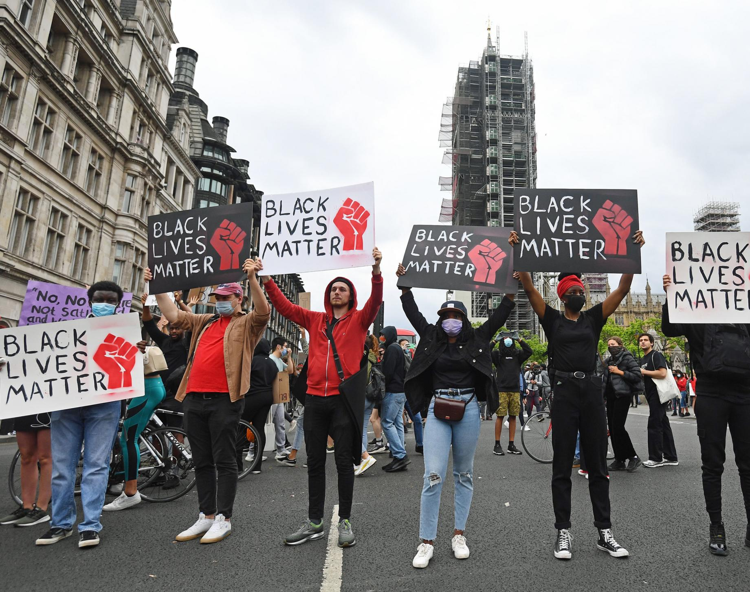
Monday 15th June 2020
Assembly
What is Racism?
What does “Black Lives Matter” mean?

Slide 2

There are many differences between people; one difference is the colour of our skin.
It is important to make sure that all people are treated fairly, and that’s why lots of people all over the country and the world are part of the Black Lives Matter movement.

Slide 3

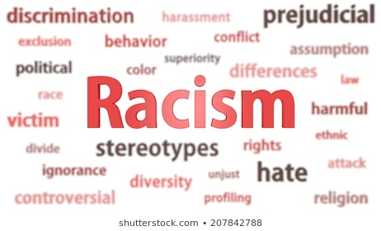
Racism is when you treat someone differently and unfairly because; of the colour of their skin or they are from a different country or their culture is different.

Slide 4
Racism and racist bullying can include:
being called names
having your belongings damaged
physical attacks
being left out
people making assumptions about you because of your skin colour, race or culture
being made to feel like you have to change how you look
racist jokes, including jokes about skin colour, nationality race or culture.

Slide 5

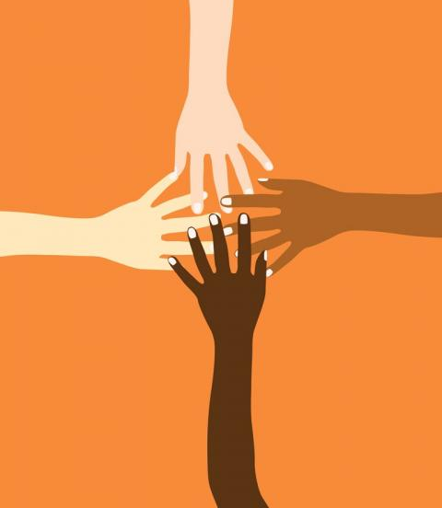
Everybody is important and has the right to be safe and happy.

Slide 6
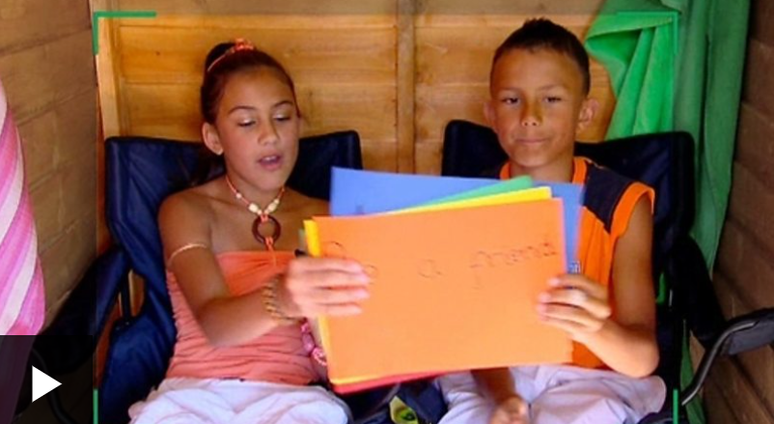
Watch this video to understand a bit more about how it feels when you experience racism.

Slide 7

4 things to remember
It's illegal to treat someone differently or unfairly because of their race or the colour of their skin.
Racism and racial bullying is wrong, even if the person doesn't realise they're doing it.
If someone commits a crime against you because of your race, religion or culture that is a hate crime.
You're not alone, and there are ways to get support.

Slide 8
Where is Racism?
Racism is all over the world and it must be stopped!
Sometimes people in power can be racist.
Sometimes they use their power to treat people unfairly.

Slide 9
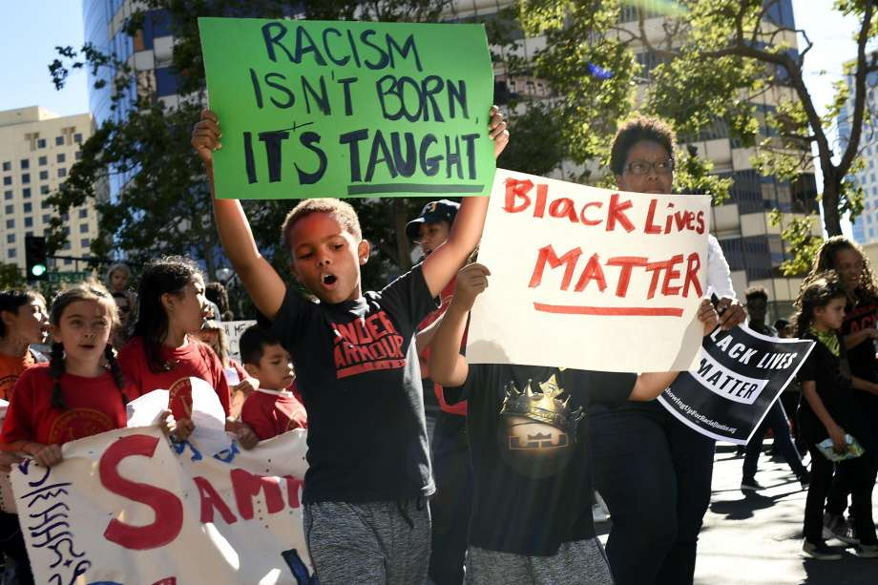

Slide 10
What is the “Black Lives Matter Movement”?
Black Lives matter is an organisation in America, Canada and England created in 2013.
Their mission is to end violence and unfair treatment towards Black communities.
This organisation holds events to educate and inform people of what happens in their communities.

Slide 11
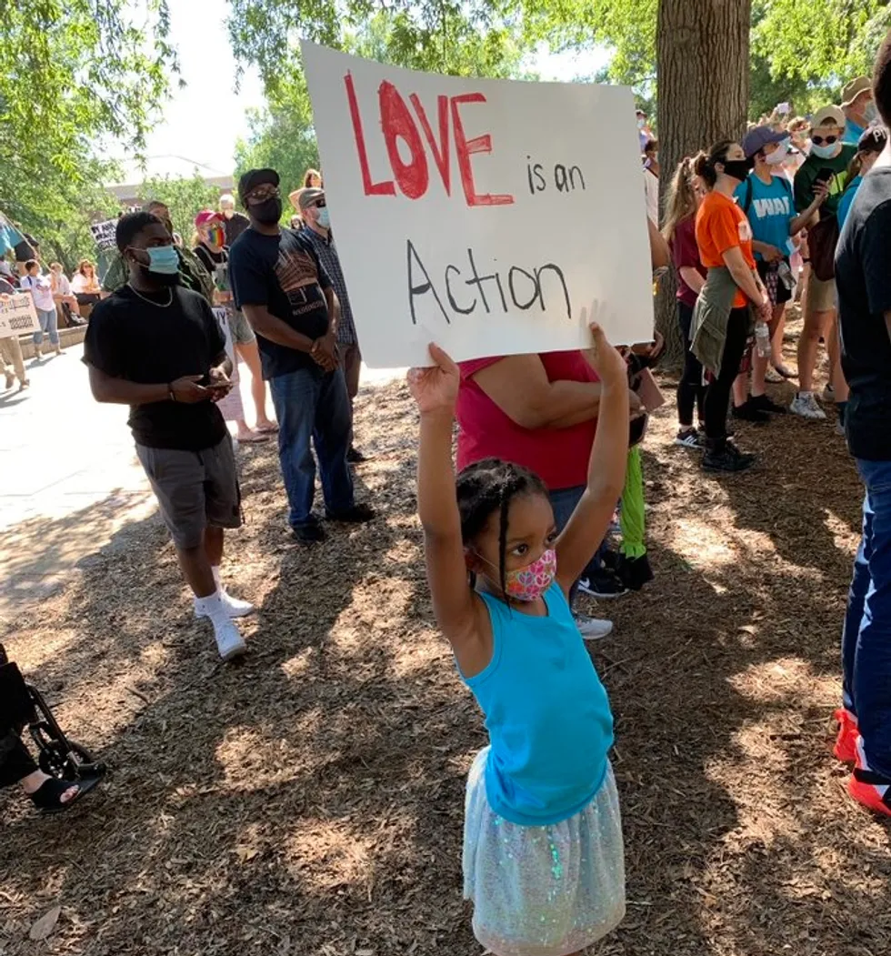
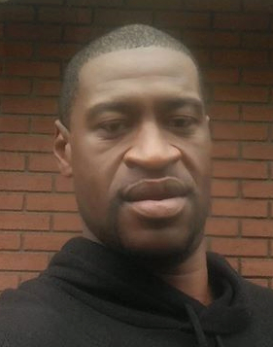
Why is this issue so important right now?
Right now, the whole world is speaking out against racism and the unfair treatment of black people, especially George Floyd who died on 25th May.

Slide 12
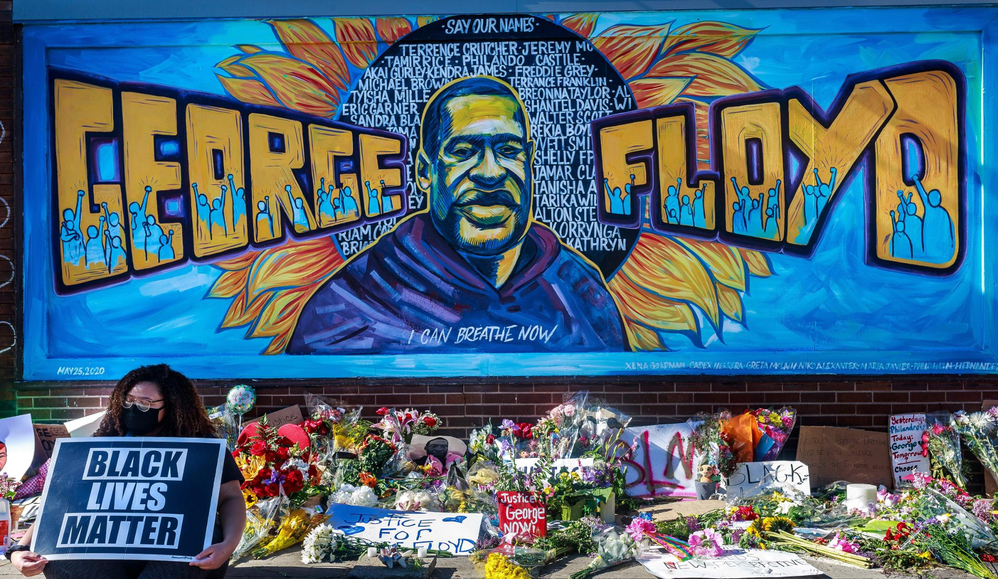
What happened to Mr Floyd has again raised the issue of racism in America and the unfair treatment that many African-American communities feel they face in the America from those in power.

Slide 13
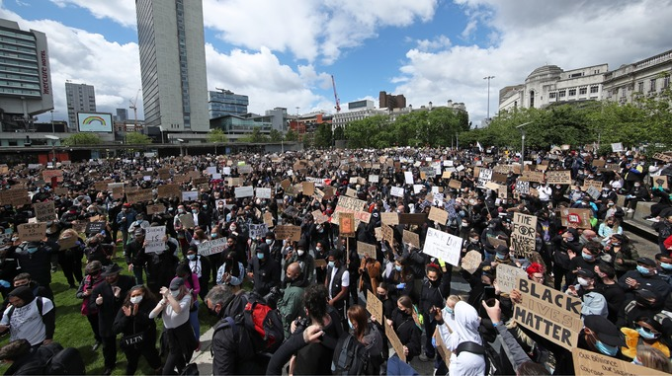
Protests in the UK
Sadly, people are also treated unfairly in England too, as well as many other countries across the globe.
Peaceful protests have happened all across the UK for the Black Lives matter movement.

Slide 14
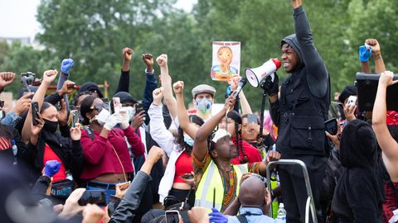
Star Wars actor, John Boyega, protested in London
John Boyega’s message: “Now is the time. Black lives have always mattered. Black lives have always been important. Black lives have always meant something.”
Lucasfilm supports John Boyega; “The evil that is racism must stop. We will commit to being part of the change that is long overdue in the world. John Boyega, you are our hero.”

Slide 15
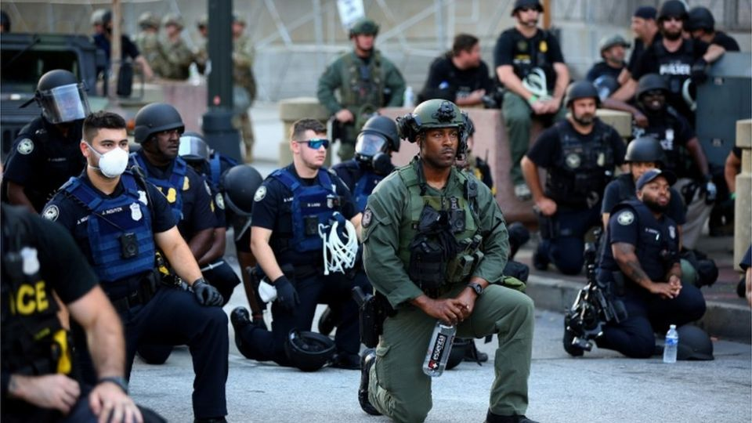
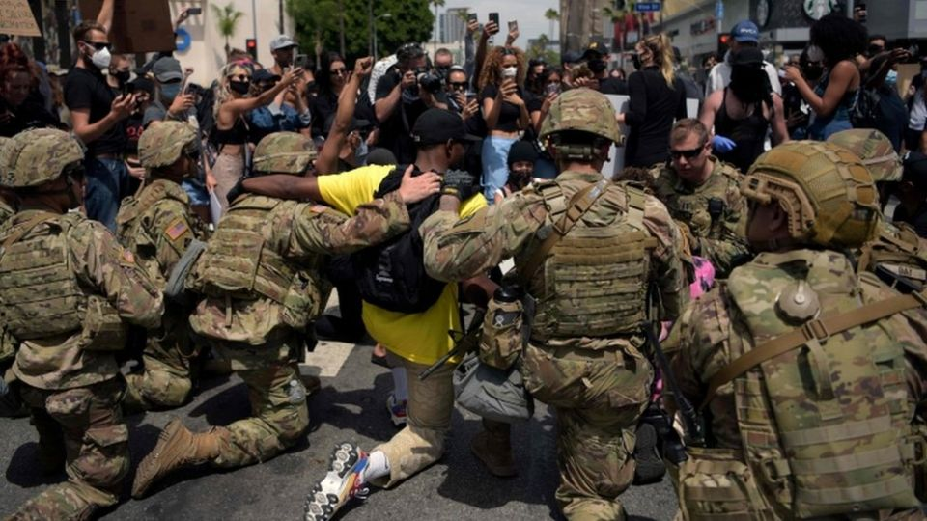
Many people support these protests against inequality and Racism.

Slide 16
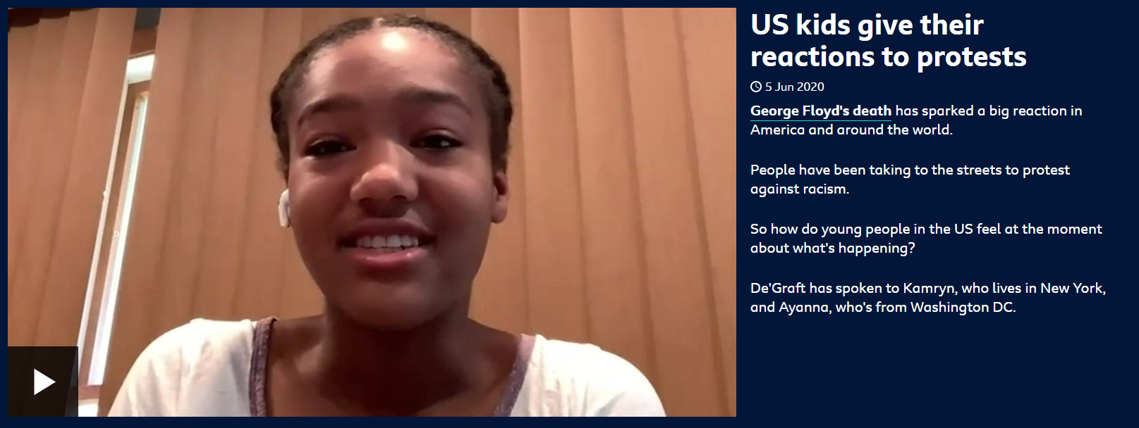
What do children in America think at the moment?

Slide 17
What can YOU do?
If someone is calling you names or making you feel scared or treating you unfairly, you can get help to make this stop.
Walk away. If someone is being racist towards you right now, walk away to keep safe and don't retaliate or respond.
Tell someone what's happening. This could be your teacher, sports coach or your manager at work. Remember you can always ask to speak to someone's boss about racism, wherever you are.
Keep safe. Walk home from school with someone you know and keep your phone charged. Calling emergency services on 999 or Childline on 0800 1111 are both free calls.
Stay safe online. Change your privacy settings, report abuse on the site or app and block users who bully you or make discriminatory comments or threats.
Keep a record. messages, videos or a diary of what's been happening can help when telling an adult or be used as evidence.
Keep telling. You may have to speak out more than once about racism or racial bullying. It's okay to tell someone else if you don't feel it's being taken seriously.
Find someone who will help. It can take time for bullying to stop. Each school should have an anti-bullying policy which is there to protect you. If your school doesn't help, you can tell the police.
Tell the police. If you feel threatened or a crime has been committed, you can report to the police on 999 in an emergency or 101 at other times.

Slide 18
How to help a friend who is experiencing racism.
If you see or hear racism, racial bullying or discrimination there are ways that you can help – it is not okay to stand by and watch.
Offer your support and tell your friend that what has happened to them is wrong.
Ask your friend if they want to report the incident. You can also offer to be a witness if you feel safe and comfortable to.
Call emergency services if you need the police or an ambulance to keep your friend safe.
Make a note of what you saw and heard as soon as possible. This could be used as evidence or to make a police statement if needed.
Speak out if it's safe to. Stay calm and be assertive. You could say that you don't agree with racist comments or jokes

Slide 19
