Slide 1
Australia
By Alex

Slide 2
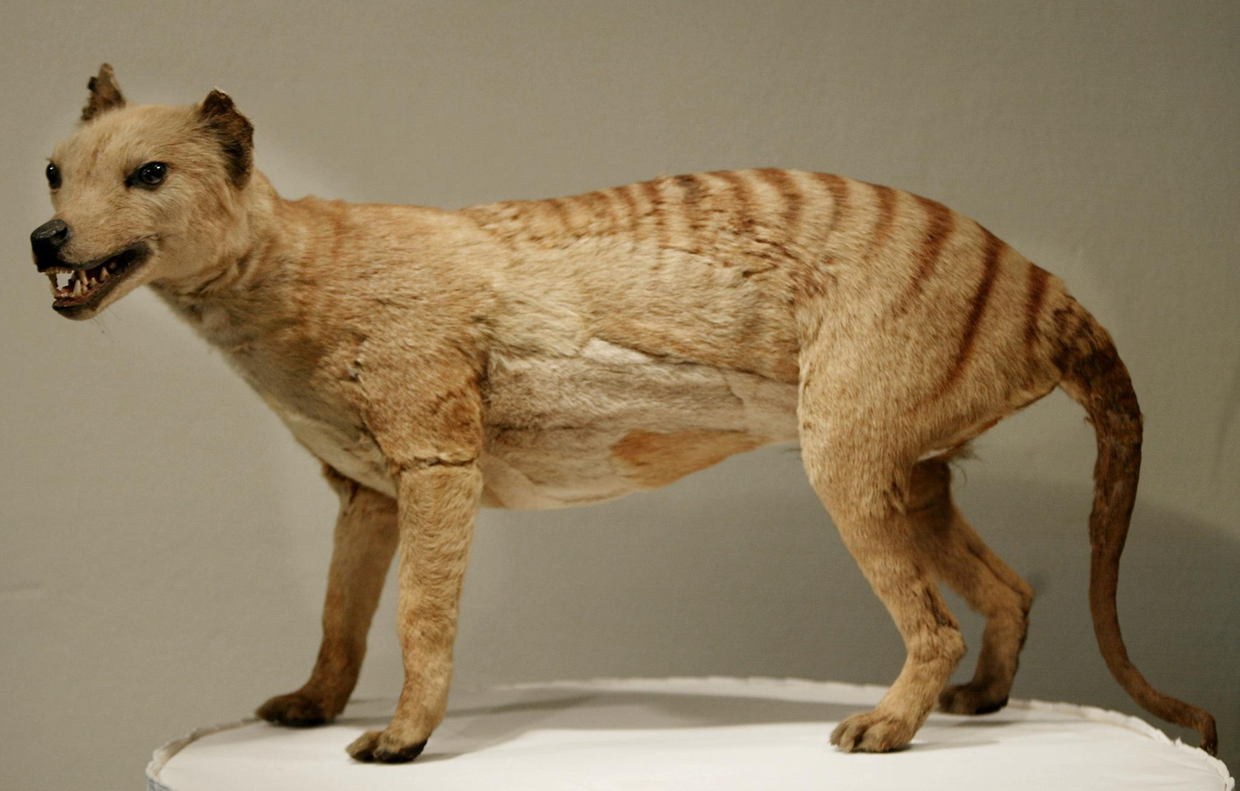
Thylacine
The thylacine is a large carnivorous marsupial now believed to be extinct. It was the only member of the family Thylacinidae to survive into modern times. It is also known as the Tasmanian Tiger or Tasmanian Wolf.
The Tasmanian tiger is thought to have been the closest relative to the tasmainian Devil.These creatures were very shy and avoided humans so were not dangerous to us. Their extinction was due to hunting by humans.
The so-called tiger, or thylacine, became extinct from the mainland about 3,000 years ago but survived in the island state of Tasmania before the last creature died at Hobart zoo in 1936.

Slide 3
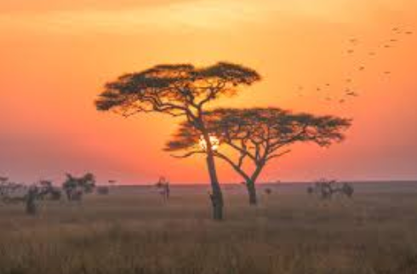
Savanna
Australia’s tropical savanna is spread over the top of Australia. It covers the northern section of Western Australia, the Northern Territory and Queensland. ... There are also tropical savannas in Africa, Asia and South America. They all have tropical climates similar to that found Australia's tropic.
There are two main kinds of grasslands: tropical and temperate. Examples of temperate grasslands include Eurasian steppes, North American prairies, and Argentine pampas. Tropical grasslands include the hot savannas of sub-Saharan Africa and northern Australia.
A savanna is a rolling grassland scattered with shrubs and isolated trees, which can be found between a tropical rainforest and desert biome. Not enough rain falls on a savanna to support forests. Savannas are also known as tropical grasslands.

Slide 4
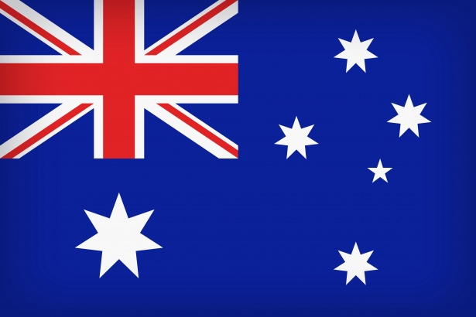
Australia flag
The flag has three elements on a blue background: the Union Jack, the Commonwealth Star and the Southern Cross. The Union Jack in the upper left corner represents the history of British settlement. ... It has seven points representing the unity of the six states and the territories of the Commonwealth of Australia.
The Australian Flag is a defaced British Blue Ensign: It has 5 stars which represent the Southern Cross and in the 1901 version the number of sides in each star represented the relative brightness of each star.
There is also an additional Star known as the Commonwealth or Federation Star.

