Slide 1
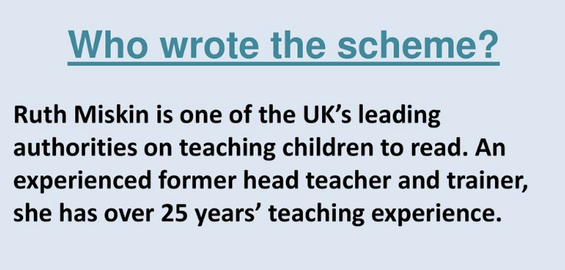
Overview of the session:
Why
How
Home

Slide 2
Why

Slide 3
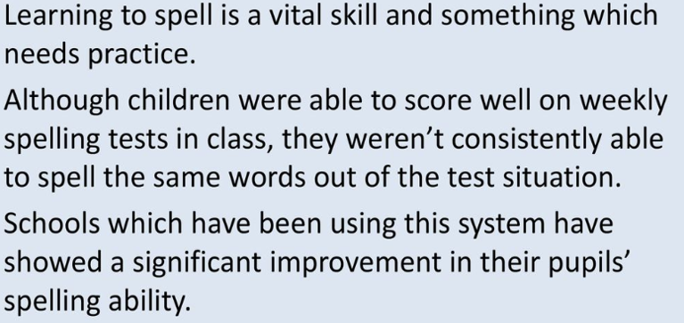
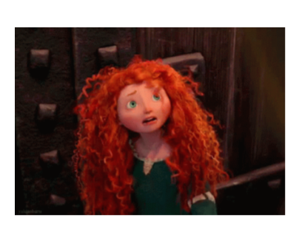

Slide 6
https://www.youtube.com/watch?v=6eh_RQ0Pkhg

Slide 8
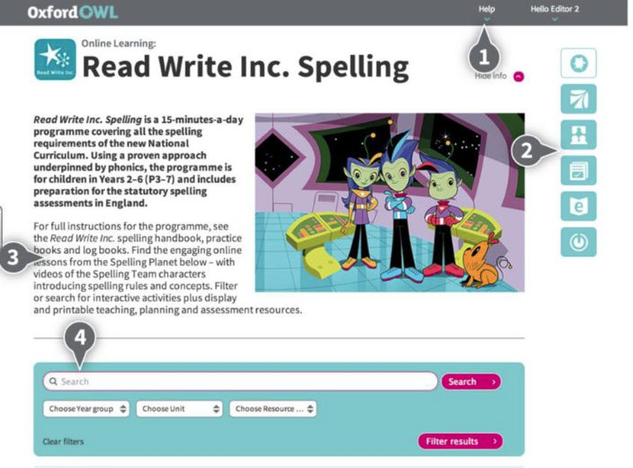

Slide 9
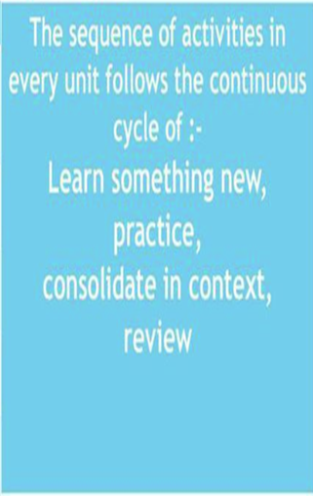

Slide 10
Each unit lasts as long as the children need it to.

Slide 11
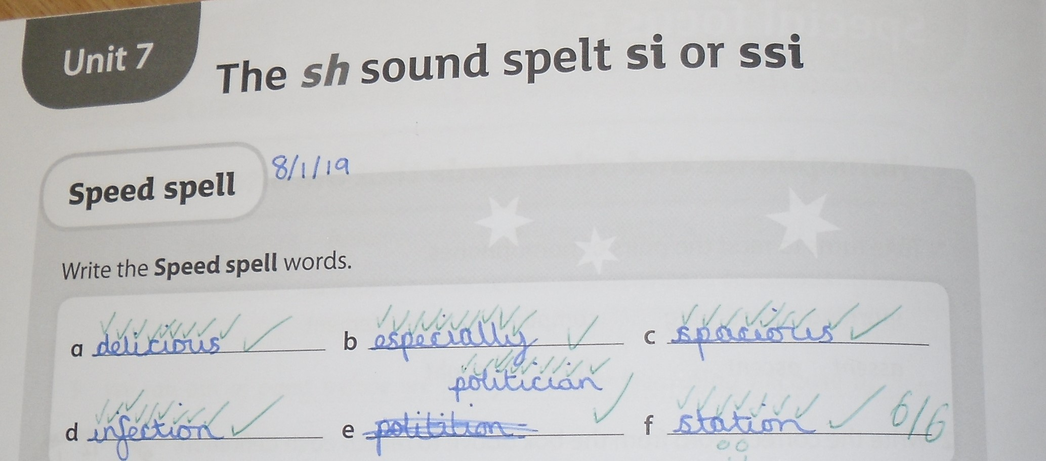
Revisiting previous spelling patterns or assessing understanding of a new pattern.

Slide 13
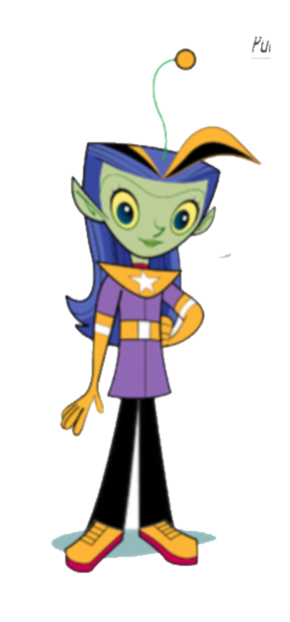

Slide 15
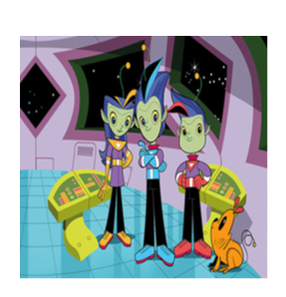

Slide 16
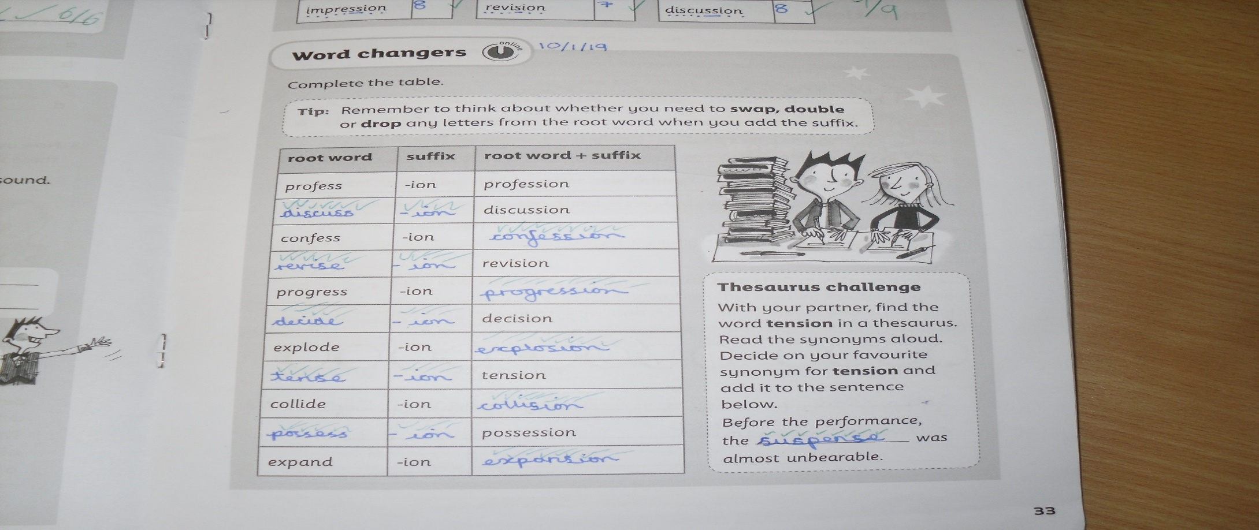

Slide 18
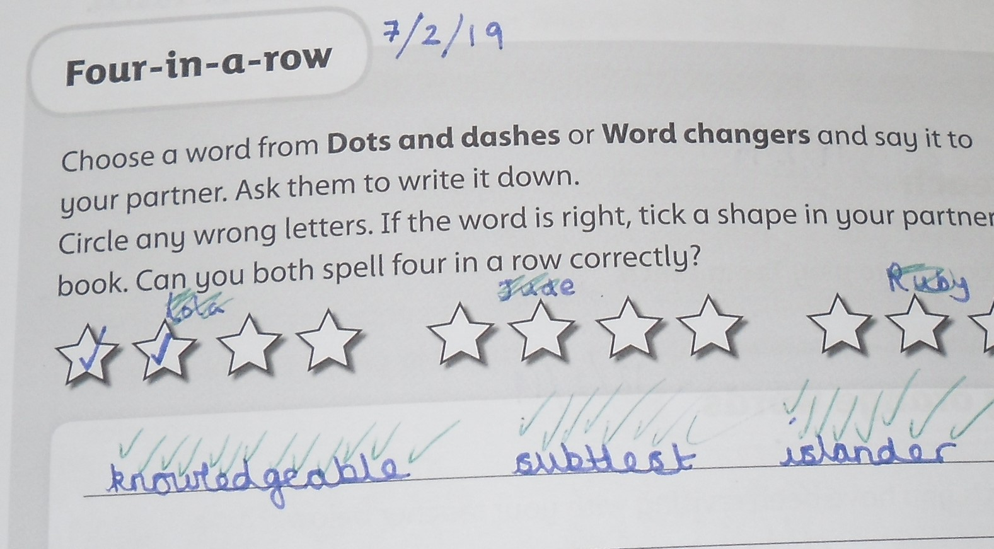
The children then practise their words by playing a game with their partner.

Slide 20
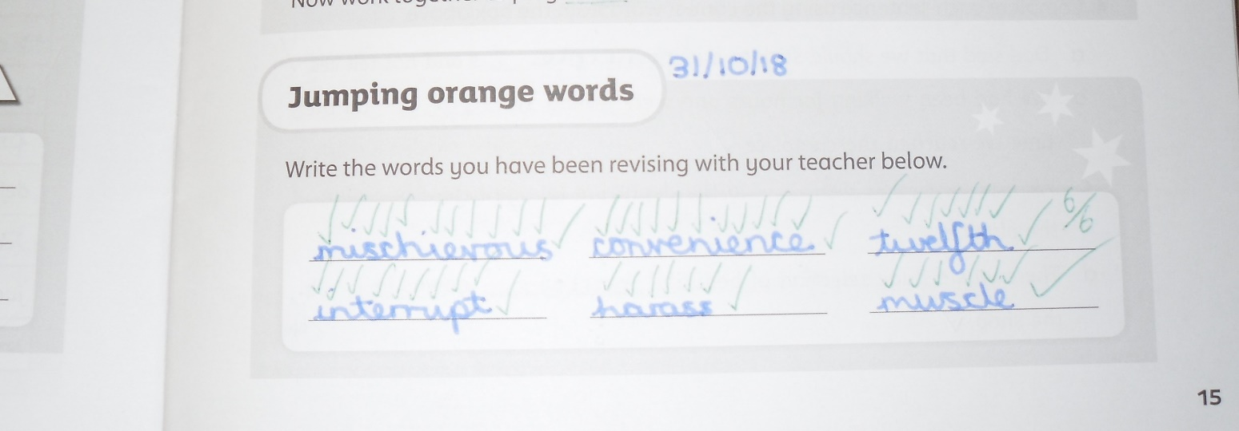
Jumping red and orange words –
These are ‘common exception words’ that don’t necessarily match the spelling patterns. We also practise these each morning for morning work.

Slide 21
Children have been asked to complete at least one practise piece in their books each week, but of course, they can do as much as they like!

Slide 22
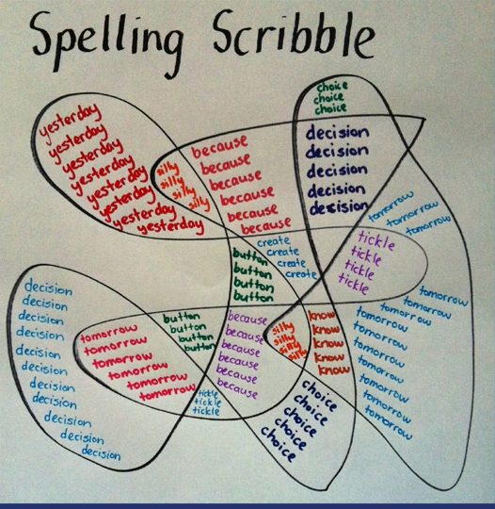
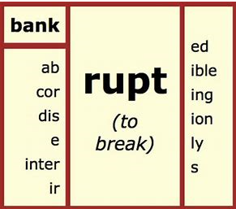
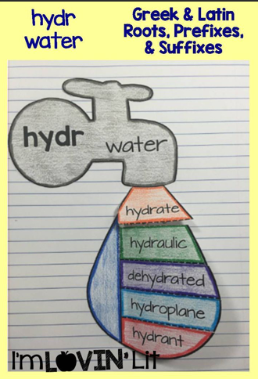
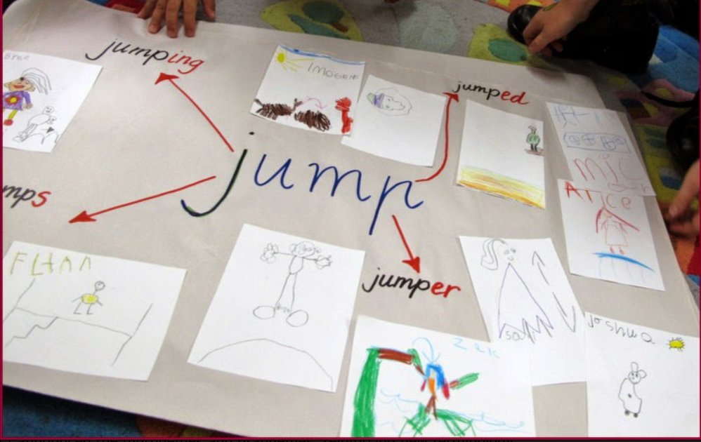
Home Learning
Varied but regular

Slide 24
